Slide 1
Goodbye Party For Miss Pushpa T.S. by Nissim Ezekiel
--

Slide 2


Slide 3
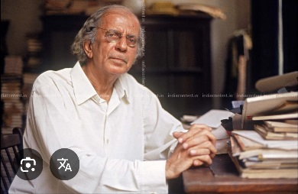
Nissim Ezekiel (1924–2004) was a pioneering Indian poet who wrote in English and is considered the father of modern Indian English poetry. He introduced realism, irony, and Indian themes into English poetry. His famous poems include Night of the Scorpion, Enterprise, The Professor, and Goodbye Party for Miss Pushpa T. S.. He received the Sahitya Akademi Award and the Padma Shri for his contribution to Indian literature

Slide 4
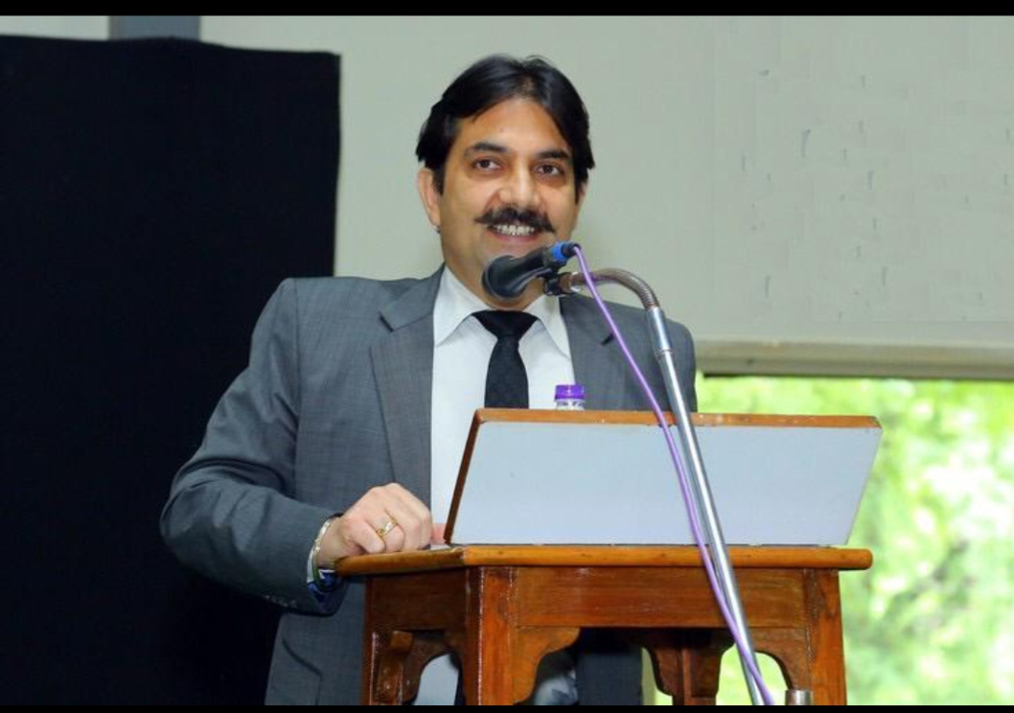

Slide 5
Friends, our dear sister is departing for foreign in two three days, and we are meeting today to wish her bon voyage.

Slide 6


Slide 7
You are all knowing, friends, What sweetness is in Miss Pushpa. I don't mean only external sweetness but internal sweetness. Miss Pushpa is smiling and smiling even for no reason but simply because she is feeling.

Slide 8


Slide 9
Miss Pushpa is coming from very high family. Her father was renowned advocate in Bulsar or Surat, I am not remembering now which place.

Slide 10
Surat? Ah, yes, once only I stayed in Surat with family members of my uncle's very old friend- his wife was cooking nicely… that was long time ago.

Slide 11
Coming back to Miss Pushpa she is most popular lady with men also and ladies also.

Slide 12


Slide 13
Whenever I asked her to do anything, she was saying, 'Just now only I will do it.' That is showing good spirit. I am always appreciating the good spirit.

Slide 14
Pushpa Miss is never saying no. Whatever I or anybody is asking she is always saying yes, and today she is going to improve her prospect and we are wishing her bon voyage. Now I ask other speakers to speak and afterwards Miss Pushpa will do summing up.

Slide 15
"is departing for foreign" → is departing for a foreign country / is going abroad
"You are all knowing" → You all know
"What sweetness is in Miss Pushpa" → How sweet Miss Pushpa is
"she is feeling" → she is feeling happy
"from very high family" → from a very distinguished family
"I am not remembering" → I do not remember
"Just now only I will do it" → I will do it right away
"Pushpa Miss" → Miss Pushpa
"she is going to improve her prospect" → she is going to improve her prospects
"will do summing up" → will give the concluding remarks / will sum up

Slide 16
Thank You will meet soon….

